Slide 1


Slide 2


AI PROJECT
STUDENTS RESULTS PREDICTOR
TEAM MEMBERS:
* MUKESHWAR RAUDRA.J
* MOHAMMED RAYAAN.B
* CHARANJET NATHAN.S
* DEGA YESWANTH
* SAMEER AHMED.S

Slide 3

INTRODUCTION TO STUDENTS RESULT PREDICTOR
This project aims to design a Student Result Predictor that leverages machine learning to forecast students' future academic outcomes.
By analyzing historical academic data and related factors, the model can provide predictive insights that help identify students who may need additional support and recognize areas that enhance overall performance
This predictive tool aims to support academic institutions in identifying at-risk students early on and encouraging timely interventions to enhance learning outcomes.
Through a data-driven approach, the Students' Result Predictor seeks to make education more personalized and proactive, helping students achieve their full potential.

Slide 4
WORKING FLOW OF STUDENTS RESULT PREDICTOR
01
02
03
04
DATA COLLECTION
SPLITTING DATA
MODEL EVALUATION
Training Set: Use a portion of the data (e.g., 80%) for model training.
Test Set: Use the remaining data (e.g., 20%) to evaluate the model's performance.
Metrics: Use metrics like accuracy, precision, recall, and RMSE (Root Mean Squared Error) to assess model performance.
Testing: Evaluate the model on the test set to check how well it predicts unseen data
Input: Gather data such as previous student scores, attendance, study hours, socioeconomic background, etc
Sources: Student databases,
academic records, surveys
DATA PREPROCESSING
Cleaning: Handle missing values, remove duplicates, and correct errors.
Normalization/Scaling: Standardize numerical data to ensure consistency.
Feature Selection: Identify key features (e.g., study hours, attendance) that impact performance

Slide 5




TOOLS AND MODULES USED
PYTHON
SCIKIT-LEARN
Python is a simple, readable programming language used for web development, data analysis, AI, and automation. Its clear syntax makes it beginner-friendly and highly versatile
Scikit-Learn is a popular Python library for machine learning, offering simple tools for tasks like classification, regression, and clustering. Built on NumPy and SciPy, it’s easy to use and widely used for data analysis and modeling
PANDAS
Train Test Split
Pandas in Python is used for data manipulation and analysis. It provides easy-to-use data structures (like Series and DataFrames) to clean, transform, and analyze data. You can handle missing data, filter, group, merge datasets, and perform statistical operations.
The train-test split is a technique used to evaluate the performance of a predictive model by dividing the dataset

Slide 6
AIM OF THE STUDENTS RESULTS PREDICTOR
FOR STUDENTS
FOR TEACHERS
Identify at-risk students early, tailor their teaching methods, and allocate resources effectively.
Gain insights into their strengths and areas that need improvement, enabling them to take proactive steps
FOR INSTITUTION
Improve overall student outcomes and enhance their reputations by offering support programs based on predictive insights.
Purpose and Importance:
Predicting academic success enables early intervention, allowing support systems to help struggling students before results are finalized.

Slide 7
EXAMPLE
MERCURY
Model Trained and results
Attendance : 80%
Mean squared Error: 2026.7478997268695
Hours studied : 7.8
Weekly study Hours: 7.5
RESULTS
Previous Score out of 500: 413
Assignments Completed (1-30): 25
Stress Level (1-10): 7
Learning style: Kinesthetic
Extracurricular Involment: Chess
Goal score for the Term out of 500: 490
Current Exam Score : 446
Attendance
72%
Current score
90%
Predicted score
89.2%

Slide 8
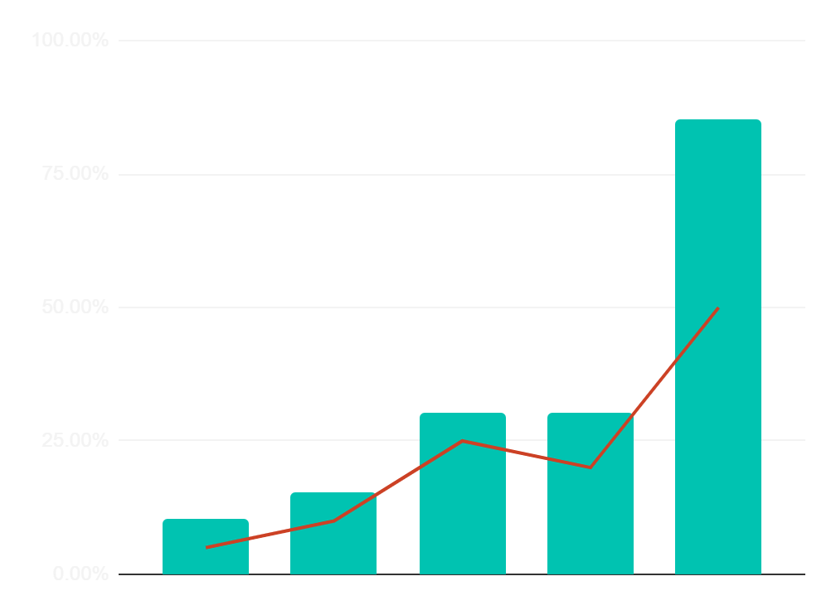
GRAPHICAL DATA OF STUDENT RESULTS
IMPROVED SCORES
SPEED OF IMPROVING 10x
PREVIOUS SCORES
CONTINUED ENHANCEMENT
JUN
AUG
OCT
NOV
DEC
“ CONSISTENCY IS THE KEY TO SUCCESS SO TRUST THE PROCESS”

Slide 9
SOFTWARE REQUIERMENTS
Libraries
MYSQL is use to store the given data of students
Matplotlib and Seaborn
· Pandas and NumPy: For data manipulation and analysis.
· Scikit-Learn: For building and training machine learning model
MYSQL
For the Visualozation of students data

Slide 10
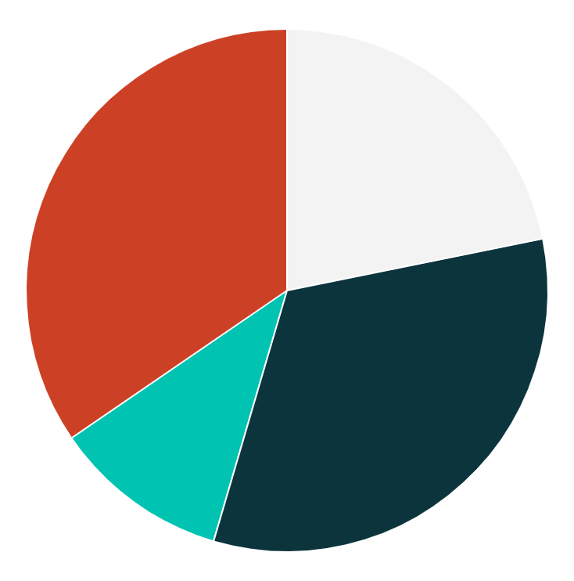
BENEFITS OF USING THE STUDENTS RESULT PREDICTOR
24%
30%
PROACTIVE MONITORING
Personalized Learning Paths
Enables continuous tracking of student progress, allowing early detection of issues.
Helps create individualized learning plans for students based on predicted performance.
12%
34%
Predictive Insights
Efficient Faculty Planning
Provides insights into which factors most influence student performance, guiding future improvements.
Assists teachers in managing class performance and adjusting teaching strategies accordingly.

Slide 11
SOME OTHER BENIFITS
Reduction in Dropout Rates
Supports Curriculum Development
10%
25%
Helps identify students likely to drop out, enabling intervention before it’s too late.
Allows educators to adapt the curriculum based on performance trends and prediction outcomes
Motivation Boost
Long-Term Academic Planning
50%
75%
Encourages students to improve their performance by giving them clear expectations and feedback.
Helps institutions plan for future academic needs based on predicted trends.

Slide 12
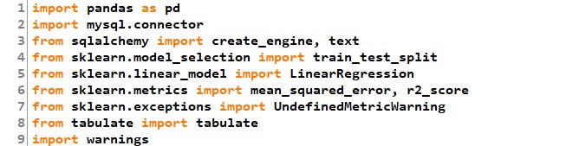
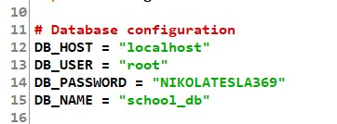
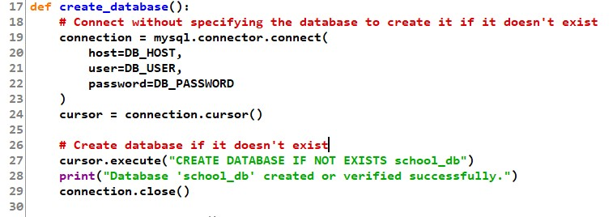
CODE

Slide 13
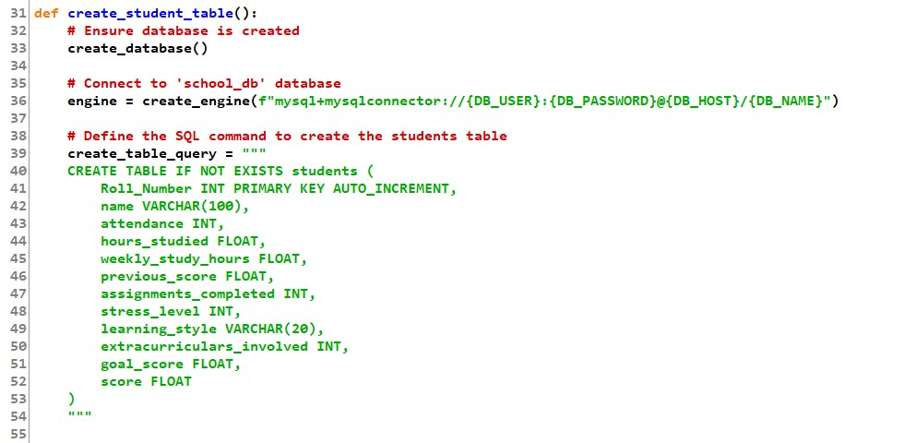
CODE

Slide 14
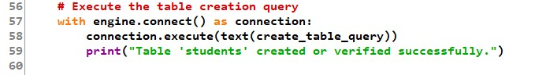
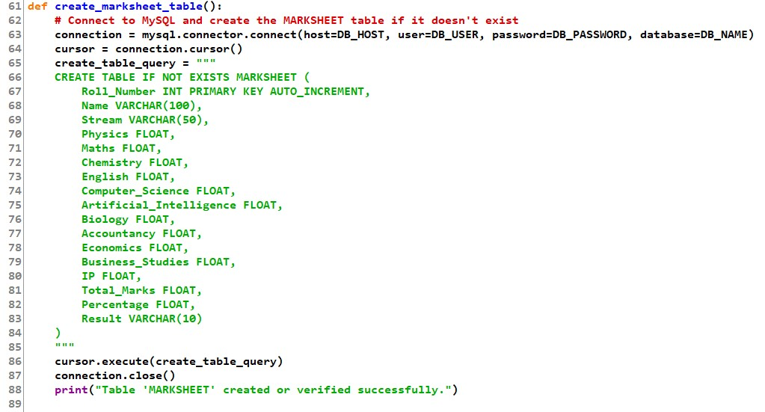
CODE

Slide 15
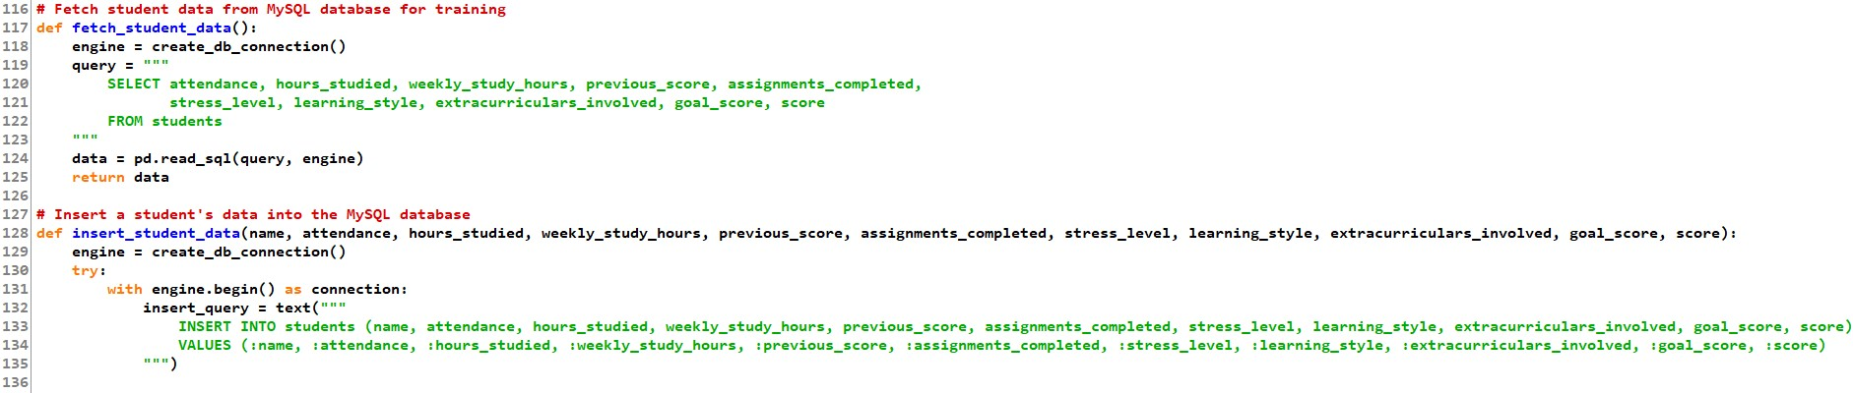
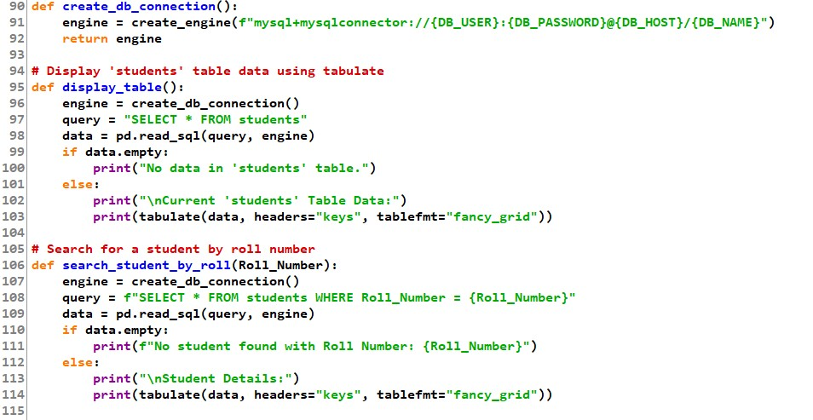
CODE

Slide 16
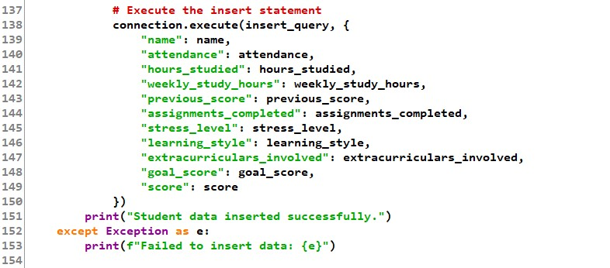
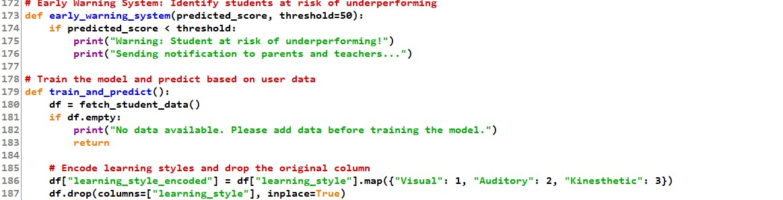
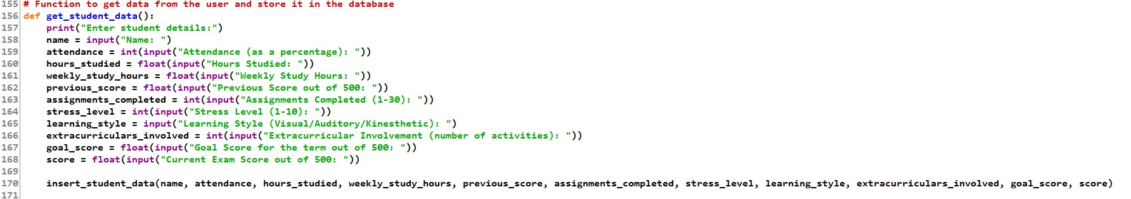
CODE

Slide 17
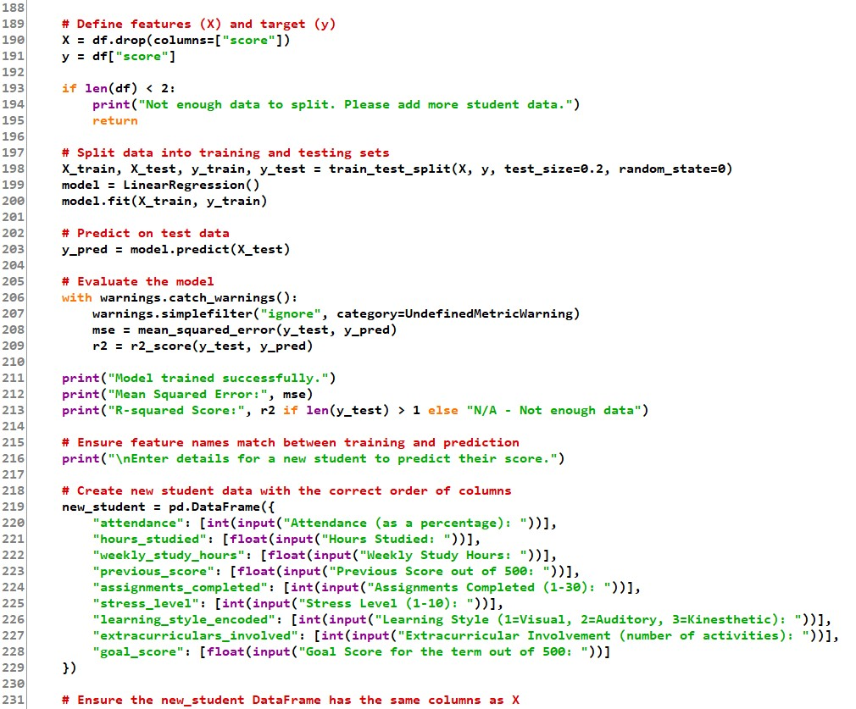
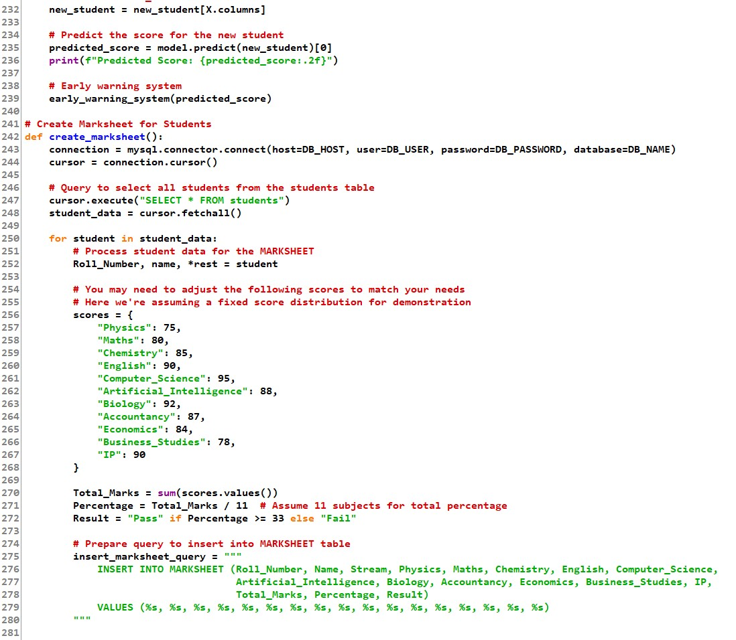
CODE

Slide 18
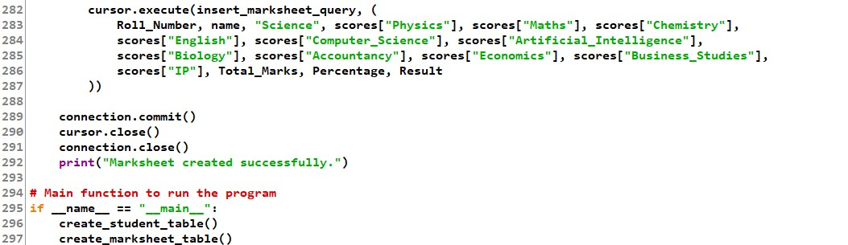
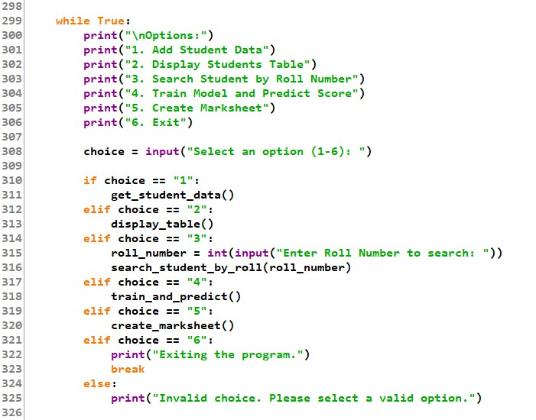

CODE
SCAN THE QR CODE TO GET THE SOURCE CODE OF THIS STUDENTS RESULTS PREDICTOR PROJECT

Slide 19
CONCLUSION
The Student Result Predictor project demonstrates the power of data-driven approaches to enhance educational outcomes. By utilizing machine learning algorithms, the model can accurately predict student performance based on a variety of factors, such as attendance, study habits, and previous academic records. This predictive capability allows for early identification of at-risk students, facilitating timely interventions that can help improve overall academic success.
In addition, the project provides valuable insights into which factors most significantly impact student performance, enabling personalized learning plans and better resource allocation. Teachers and administrators can use these predictions to make informed decisions, fostering a more targeted and efficient educational approach.
Moreover, the ability to predict student results not only supports individual students but also aids in the development of academic strategies and curriculum improvements. By leveraging these predictive insights, educational institutions can reduce dropout rates, boost success rates, and ultimately contribute to a more inclusive and supportive learning environment.
This project highlights the importance of adopting technology in education, paving the way for more efficient, proactive, and data-driven teaching and learning methods

Slide 20

.

